Slide 1
Social Media Phishing Attacks
Presented By:
J.Jyothika
CodeAlpha_Intern

Slide 2
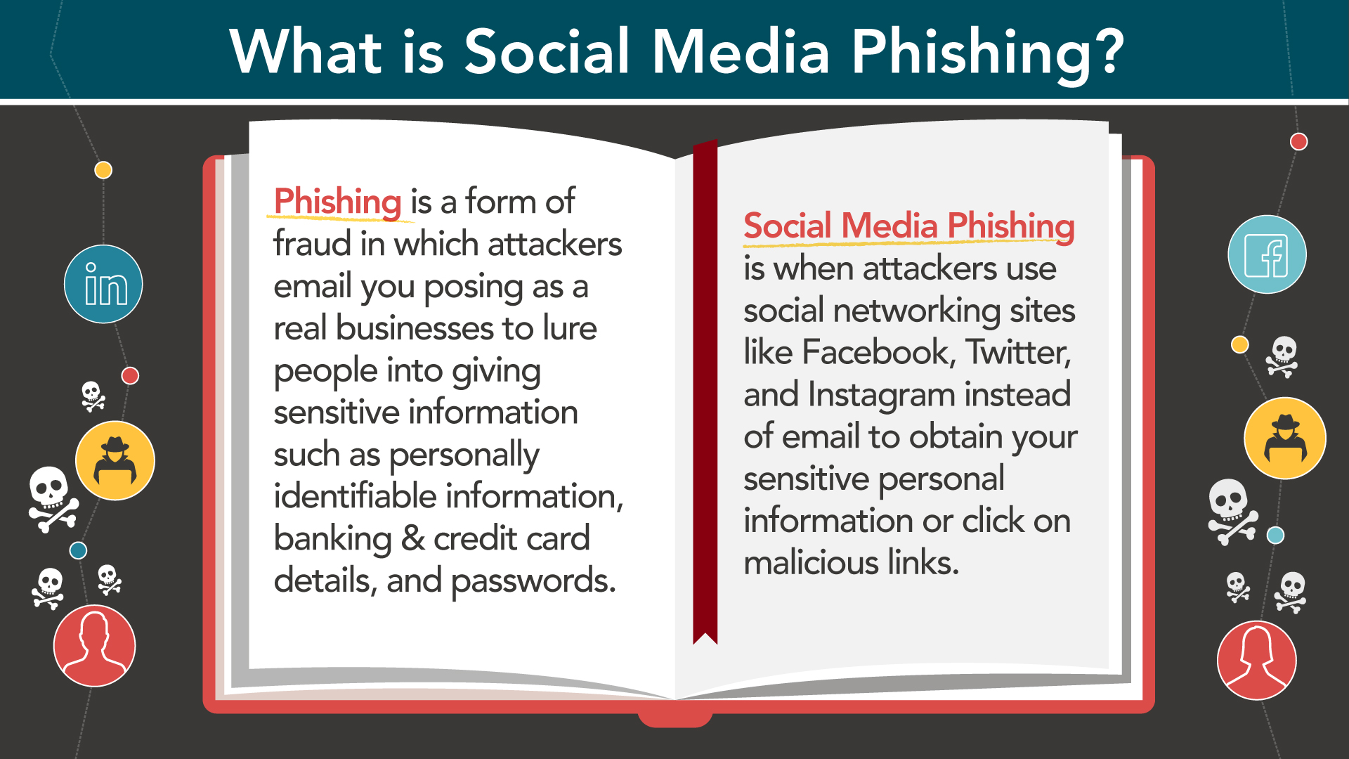

Slide 3
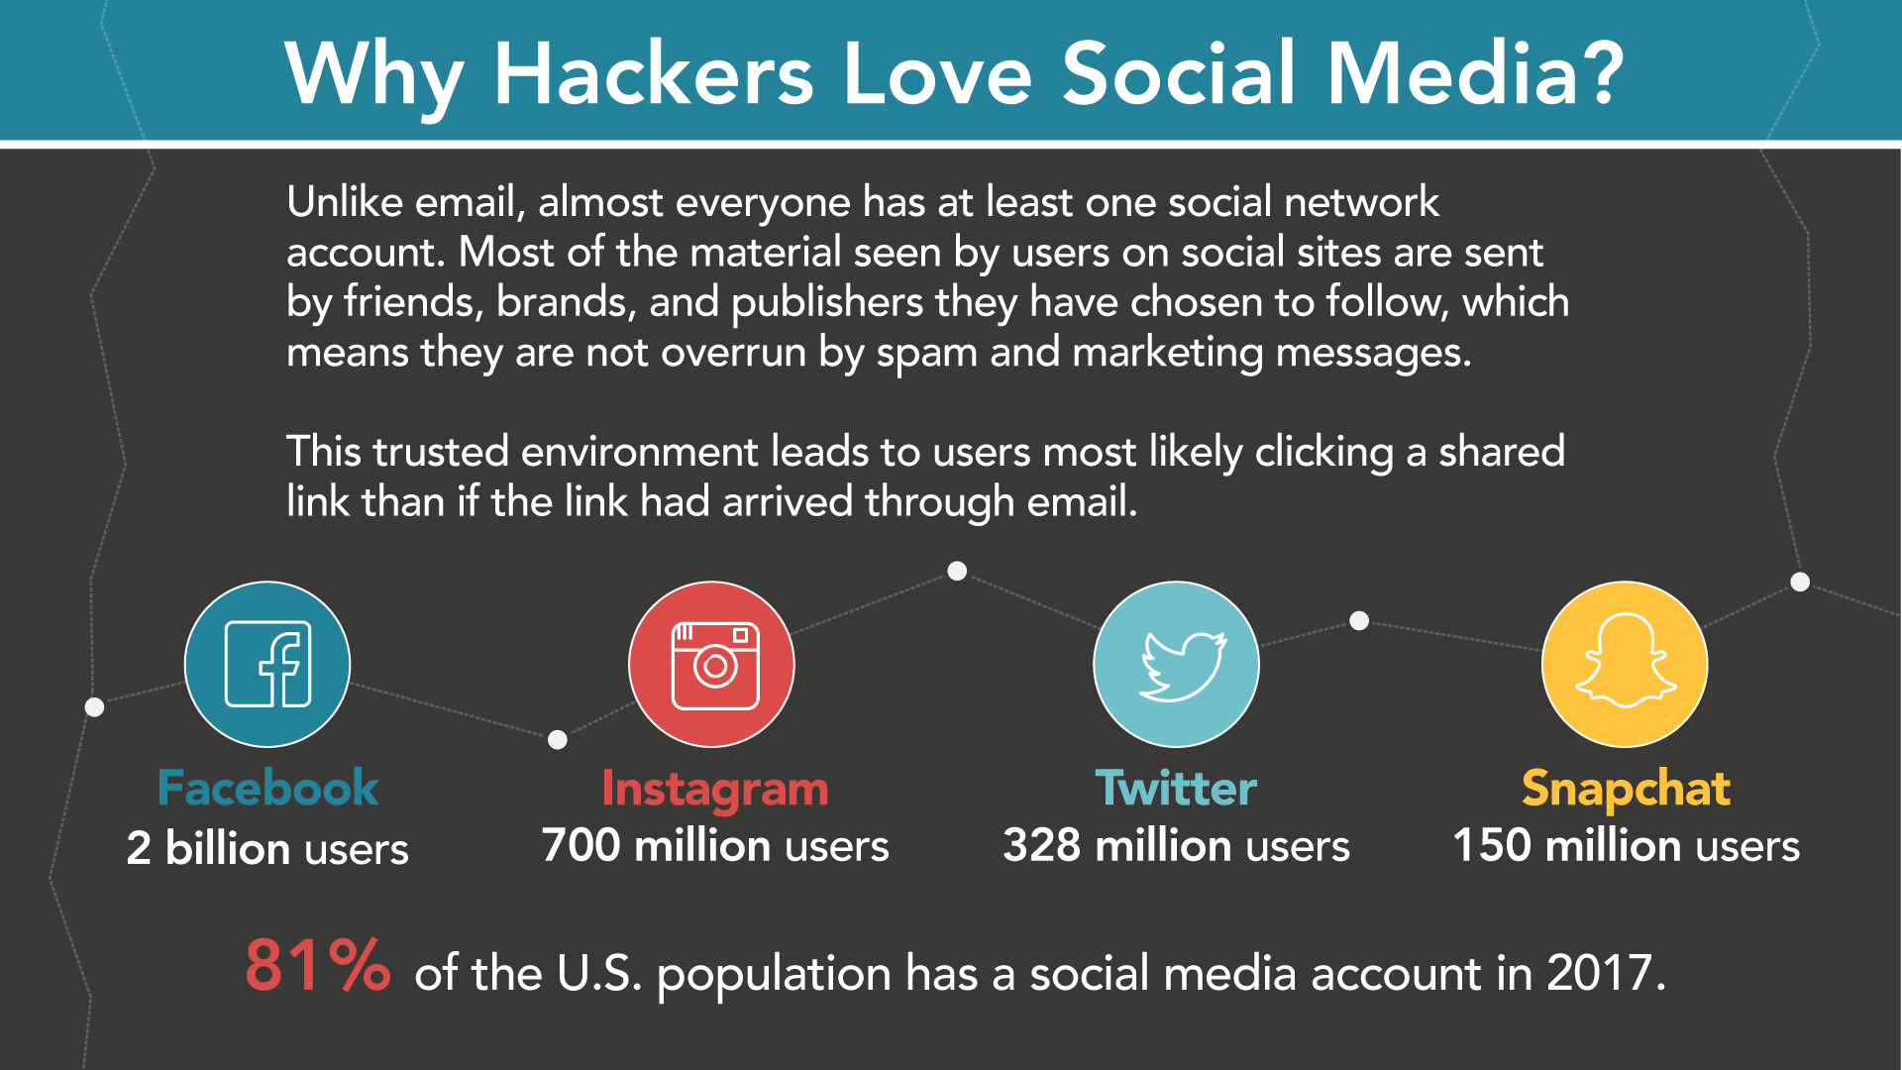

Slide 4
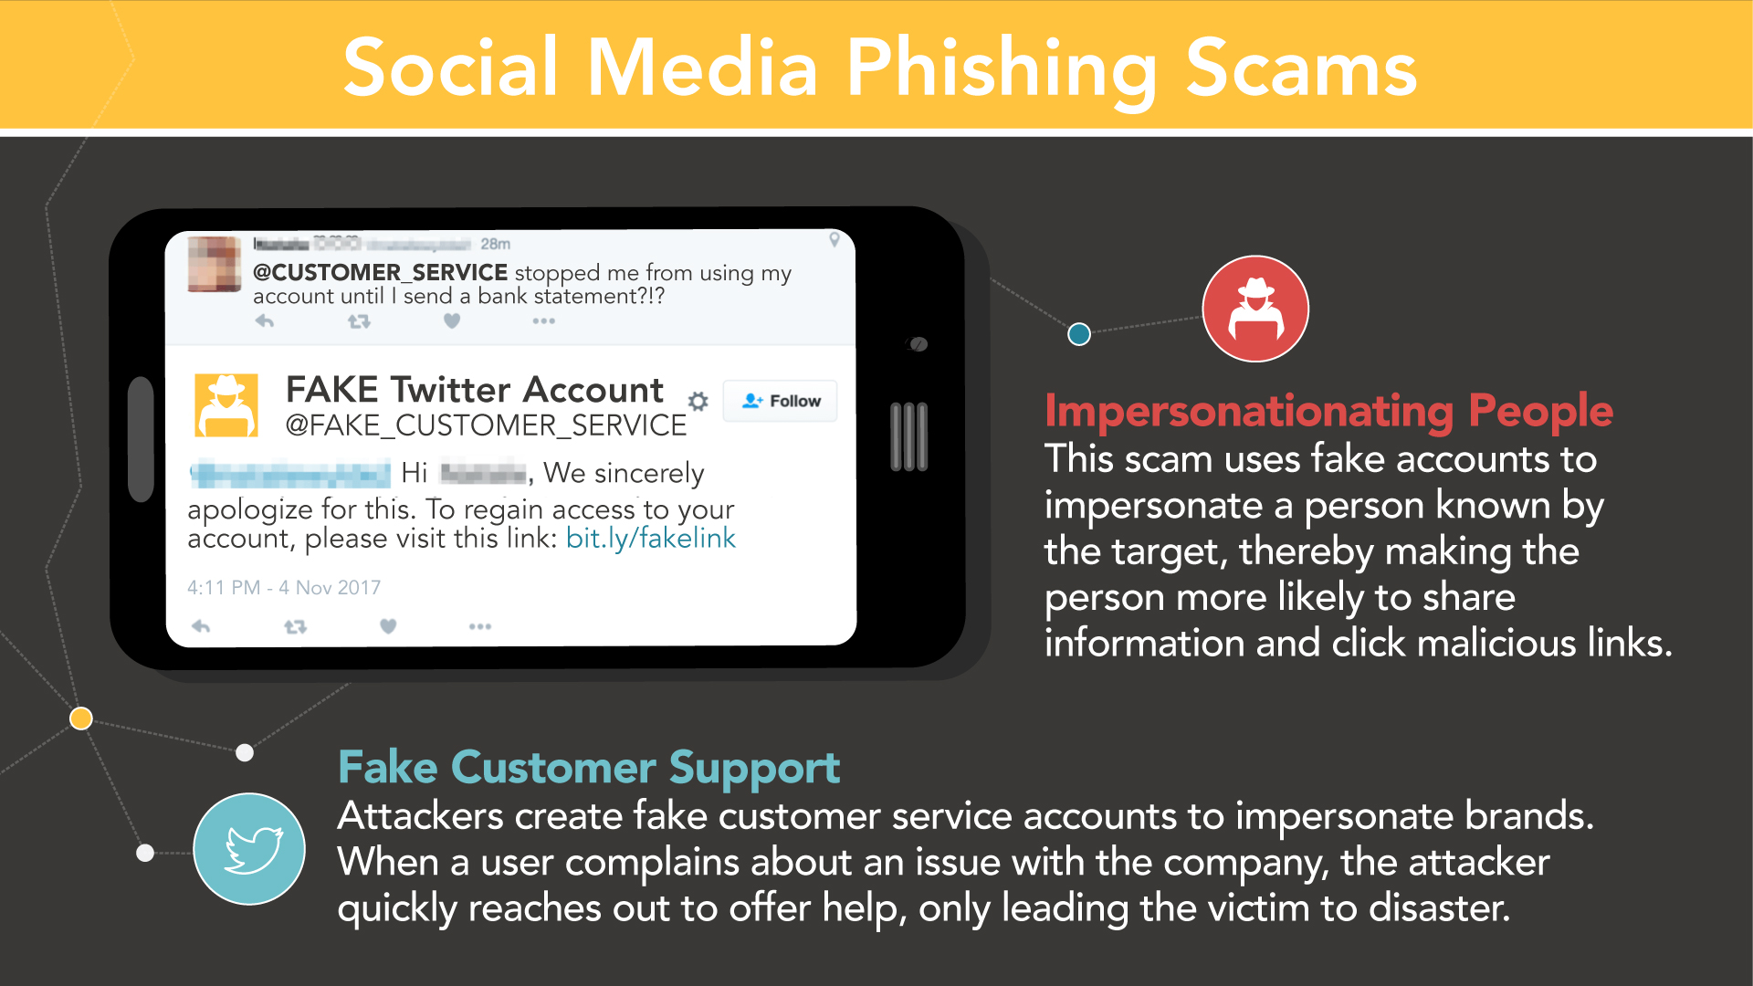

Slide 5
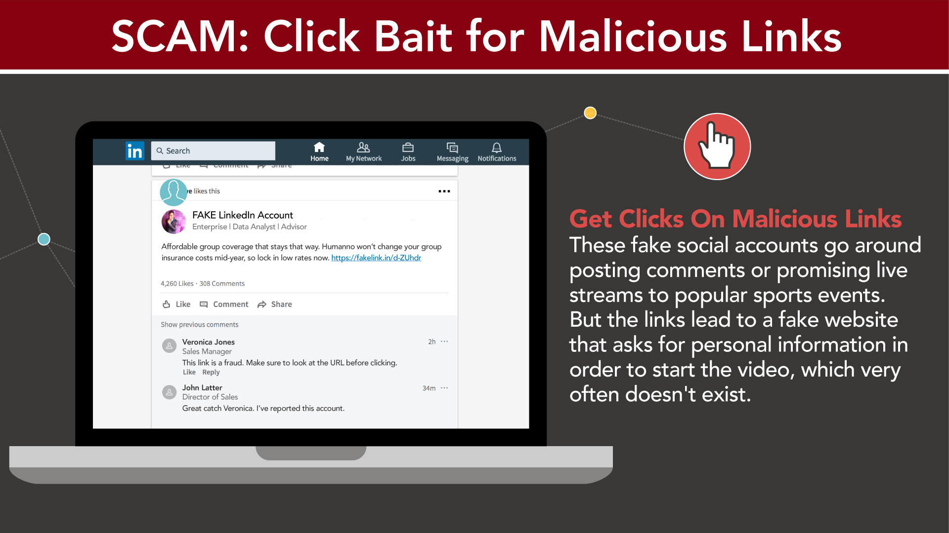

Slide 6
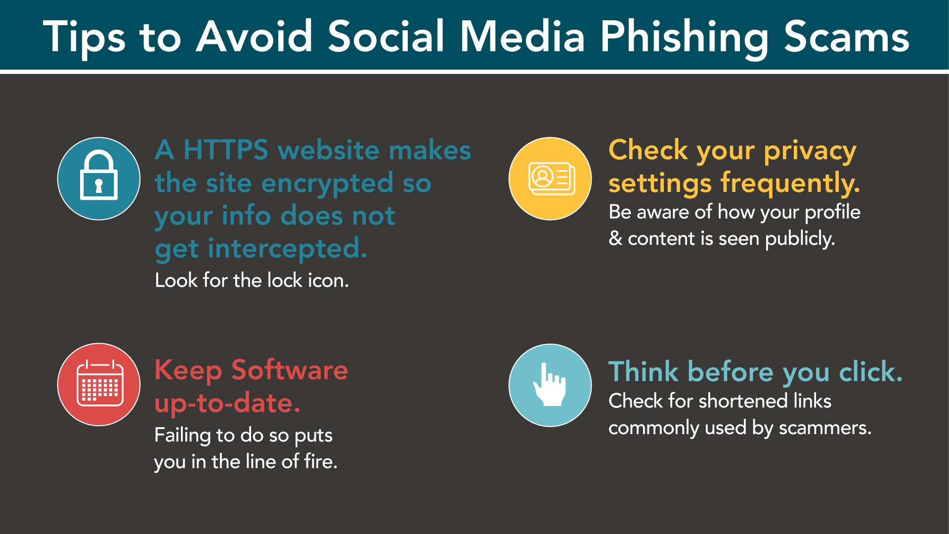

Slide 7
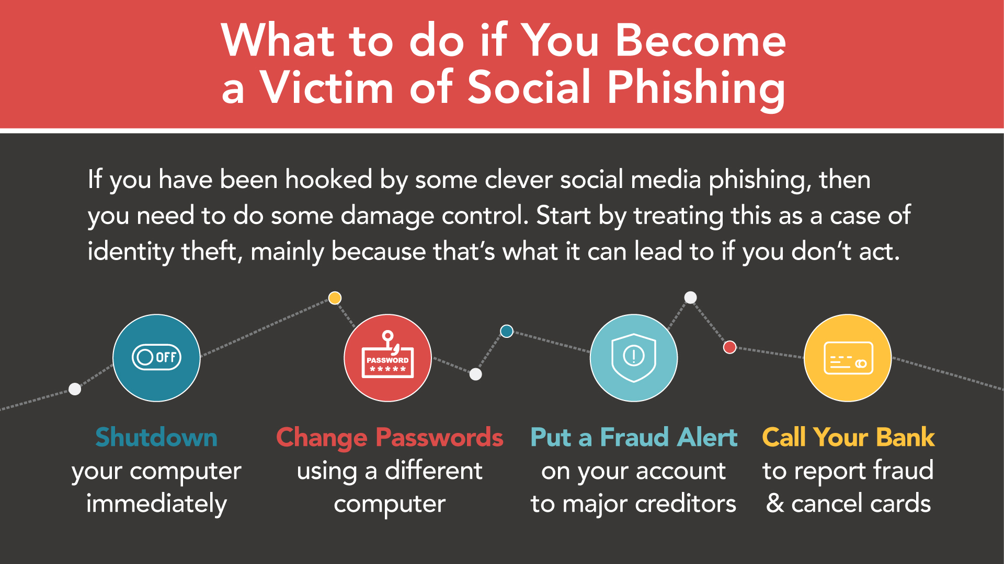

Slide 8
THANK YOU☺

